Slide 1
AnyMocap

Slide 2
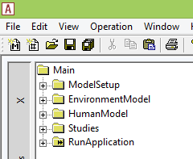
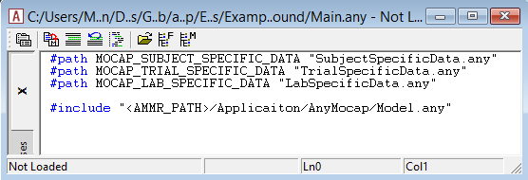
Simplified structure
In model
In file system
Flexible: Folder may be renamed/duplicated
Support multiple HumanModels
Support marker and parameter optimization of ‘environment’
Support any file structure
Separate user/application files

Slide 3
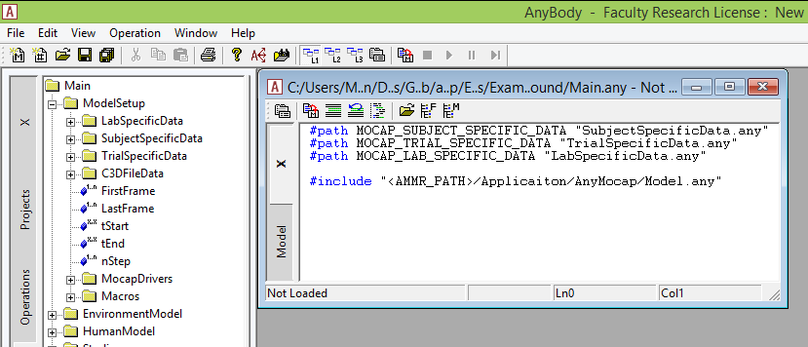
Fewer hardcoded things
New tempates
New version file:
MarkerClass templates
ForcePlate templates
Optimize Antrometric tempate
Hardcoded

Slide 4
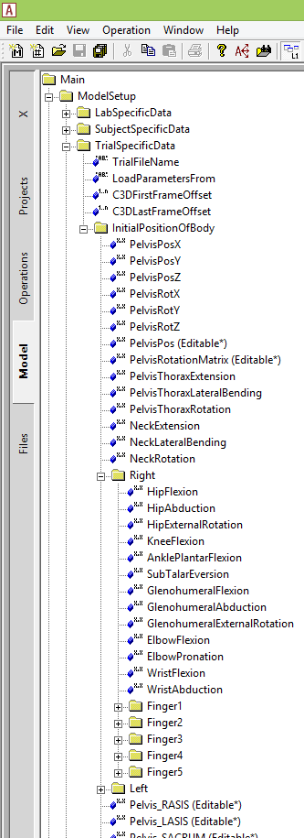
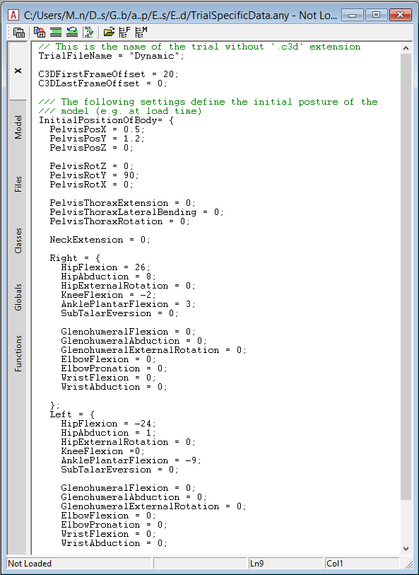
Required settings have default values

Slide 5
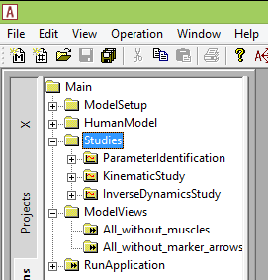
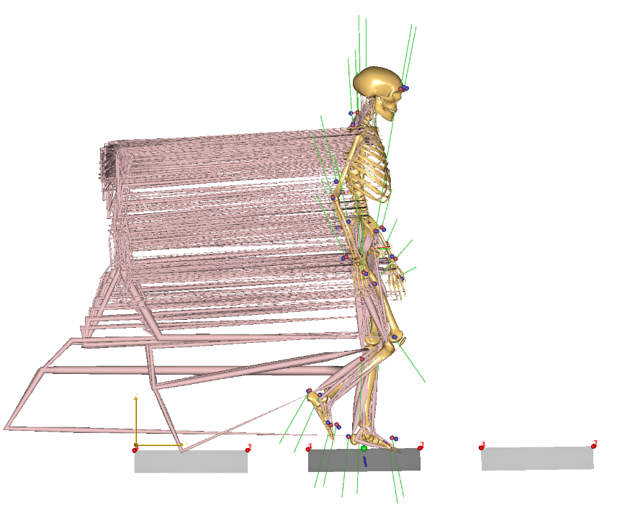
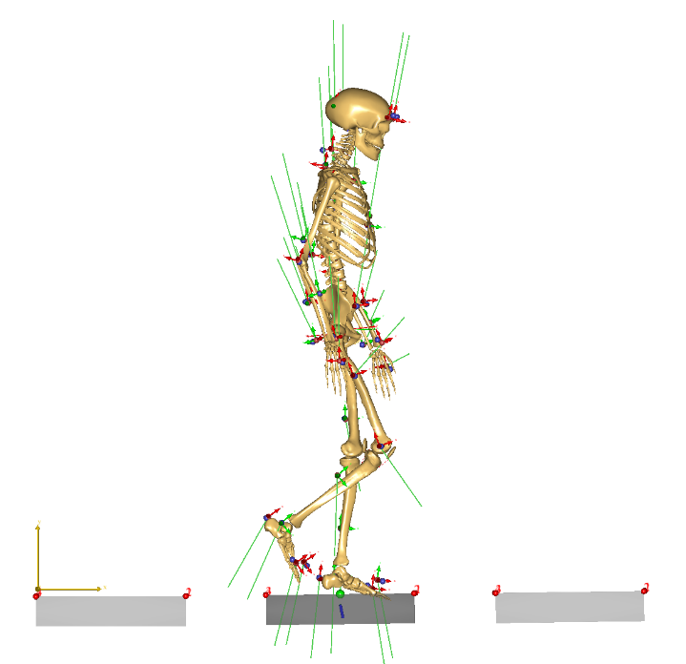
One study to rule them all..
Muscles are always loaded (hidden using views/macros)
Still separate kinematic and inverse dynamic model
Transferring joint angles remains an issue
Kinematics and inverse dynamics in one model
Notes:
Inverse dyanmics and markers

Slide 6
Check list from last meeting
Exclude marker
Initial position of model (calculated using markers)
Initial segment scaling (calculated using markers)
Range of motion for joints (to assist kinematics)
GRF prediction
Model independent of windows folder structure
Model independent of AnyScript folder structure (position of HumanModel and EnvironmentModel, C3DFileData etc)
tStart/tEnd perturbation to allow calc of Vel and Acc in the inverse dynamic model
Parameters of #define ?????
Marker drop-out handling
Marker renaming vs. standard protocols
Single Model-load-step
Separation of Trial/subject/lab specific data.
Fusion of AnyGait/Mocap
Optimization of bodypart without marker ?????? (ST)
Multiple calibration trials ( standing, dynamic reference)
Study to just visualize the C3D data
Comparing trials ??????
Easy to read and understand model ( hiding vs. showing the complexity of model)
Residual reduction algorithm to segment parameters (mass/inertia)
More environment directly created from the c3d files.

Slide 7
Version 0.1: Running with AMS 6.0.4 implying that overall structure is fixed
AMS 6.0.4
fix no-files handling (MD)
Fix reference bug (MEL bugreport) (MD/JDT)
SetView ClassOperation (JDT)
OptStudy: (MD)
No DesVar handling
Better DesVar linkage (pointer, PickDown)
DesVar reference does not save/load properly (MEL bugreport)
Save as anyset
DesVar (marker) visualization (e.g. via DesVar::Active or DesStudyPtrArr set by studies)
Class Templates parser issues (JDT)
Dots in default argument values
Minus in (front off)template argument values
C3Dreader (MD)
Bug: Filters do not work when no analog data
Disable filters (+ warning) when single/too few samples (BUG)
AnyMoCap
Restructured model for readability and easy access
Separation of Trial/subject/lab specific data (MEL)
2-step analysis with file-based data transfer
Remove muscles for faster kinematics (using double-load procedure) (MEL)
ExtraDrivers included properly (depends on reference bug) (MEL)
StandingReference -> multiple linked trials (MEL)
Multiple marker protocols
Saving design vars when ParameterOpt exists
Loading Design from previous trial ????
Exclude markers in specific trials (weight, MechObjectExclude, ..) (MEL/MD)
Version 0.2: (more ready to users without special introduction)
Documentation
General document/slides
Parameter descriptions (systematic way)
DocComments in code
Example
Test
LTHT
ETH
Hammel
TLEMsafe
Vicon plugin
Version 0.3: AMS 6.1 features
Make it unnecessary to consider ApproxVelAccPertubation in tStart and tEnd
Make ApproxVelAccPertubation perturb only inside the interval
Make Interpol functions work outside interval
Version 1.0 (in AMMR 1.7, AMS 6.1):
Template model
Version 2.0
GRF update
GRF prediction
Force plates from C3D reader
Simple coupling between feet and already defined force plates (if needed, i.e. when not using GRF prediction)
Single model load and single study functionality

